Slide 1
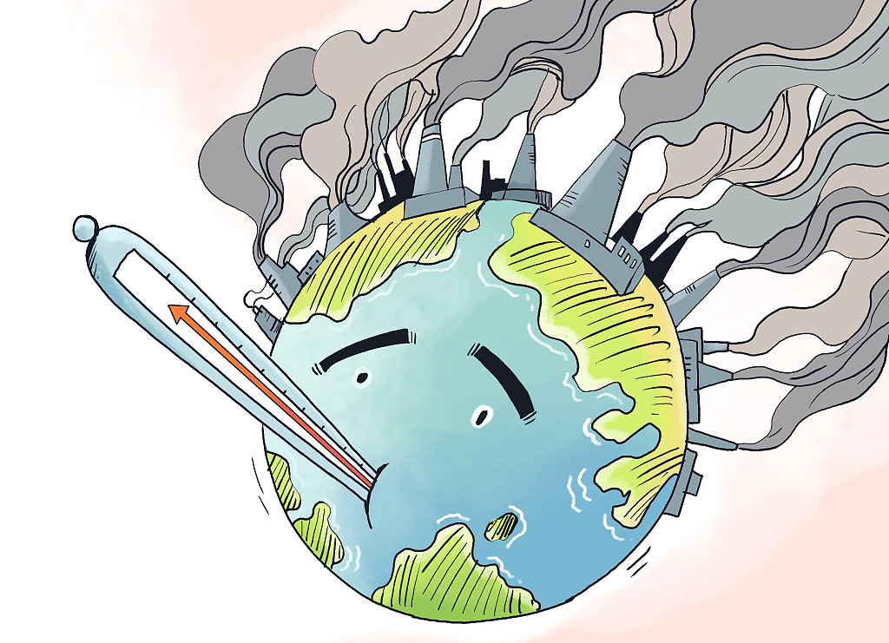
CO2 emission
Ram Pakanayev & Michelle Chorny

Slide 2

Our research question
Prediction of CO2 emission - in mega tones
by countries in the years 1990-2019

Slide 3

Why we choose this topic?
We find the climate change situation very important, so we decided to do our research on CO2 emission. Carbon emissions such as CO2 raise global temperatures by trapping solar energy in the atmosphere. This alters:
water supplies and weather patterns
changes the growing season for food crops
threatens coastal communities with increasing sea levels.
Heat
trapped

Slide 4

About the project
In our project we gathered data about the CO2 emission of 77 countries all over the world from 1990 till 2019.
Our main goal was to predict the CO2 emission per year by country.

Slide 5
Part of our features
CO2 Total Mt-
CO2 emission in mega tones
Generation GWh-
amount of electricity produced in 1B\hour
consumption GWh- consumption of electricity
installed capacity MW-
maximum of electricity that cand be produced
Renewable installed capacity MW- maximum of electricity that cand be produced from renewable
Renewable generation GWh-
comes from natural sources or processes that are constantly replenished.

Slide 6

Data Acquisition

Slide 7

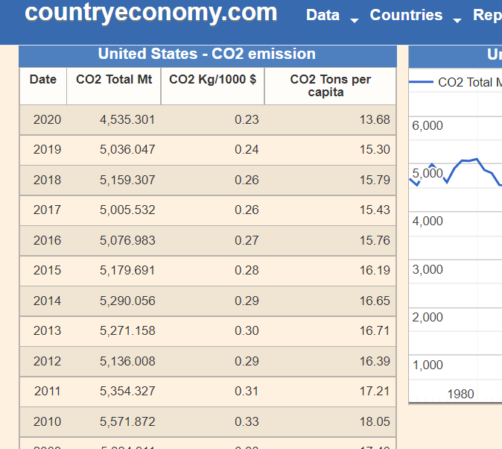
Crawling
The method we used to extract the data is by using ‘BeautifulSoup’ library to crawl the relevant records. With our crawler we scraped tables of CO2 emission, electricity consumption, population and more by countries per years from the countryeconomy website.
Data Acquisition
Data Cleaning
EDA
Machine Learning
Conclusions

Slide 8
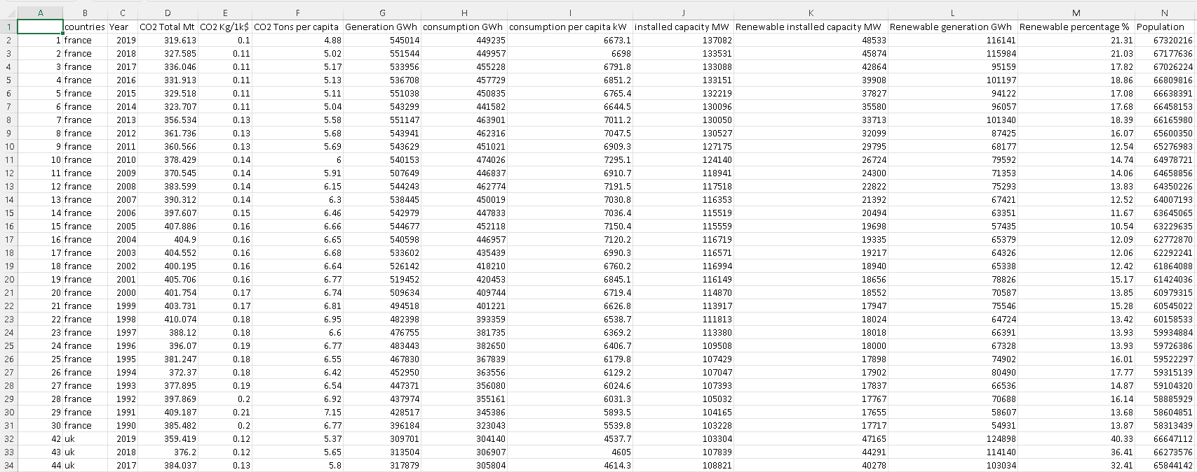
Crawling
Finally we saved all the records into a dataframe called ‘Big Table’.
Data Acquisition
Data Cleaning
EDA
Machine Learning
Conclusions

Slide 9

Data Cleaning

Slide 10

Data cleaning:
After crawling our data we started cleaning it. We noticed that there were too many rows with too many missing values in the years before 1990 so we decided to drop those rows. In edition, we also dropped the data from 2020.
Data Acquisition
Data Cleaning
EDA
Machine Learning
Conclusions

Slide 11
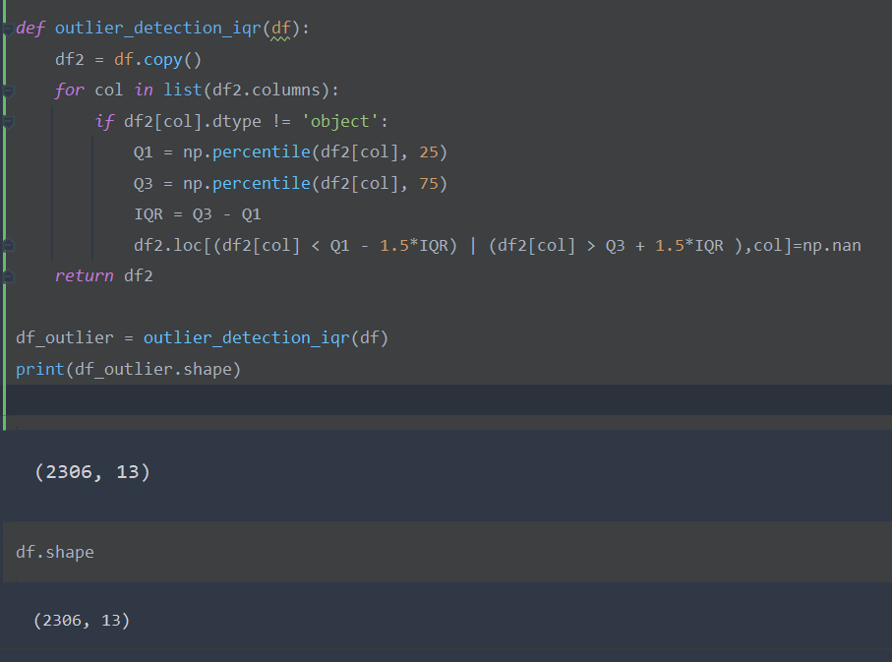
Outliers
As you can see we have no outliers.
Data Acquisition
Data Cleaning
EDA
Machine Learning
Conclusions

Slide 12

EDA Exploratory data analysis

Slide 13

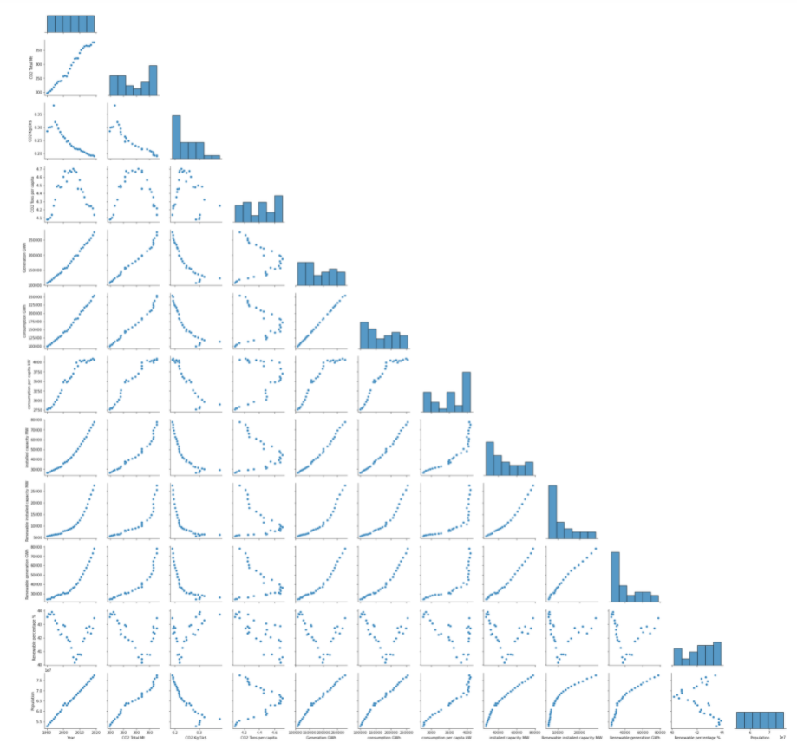
EDA questions:
Energy consumption vs generation
Energy consumption vs population
CO2 emission per continents
Is these a connection between the CO2 emission and whether the country is developed or developing?
Data Acquisition
Data Cleaning
EDA
Machine Learning
Conclusions

Slide 14

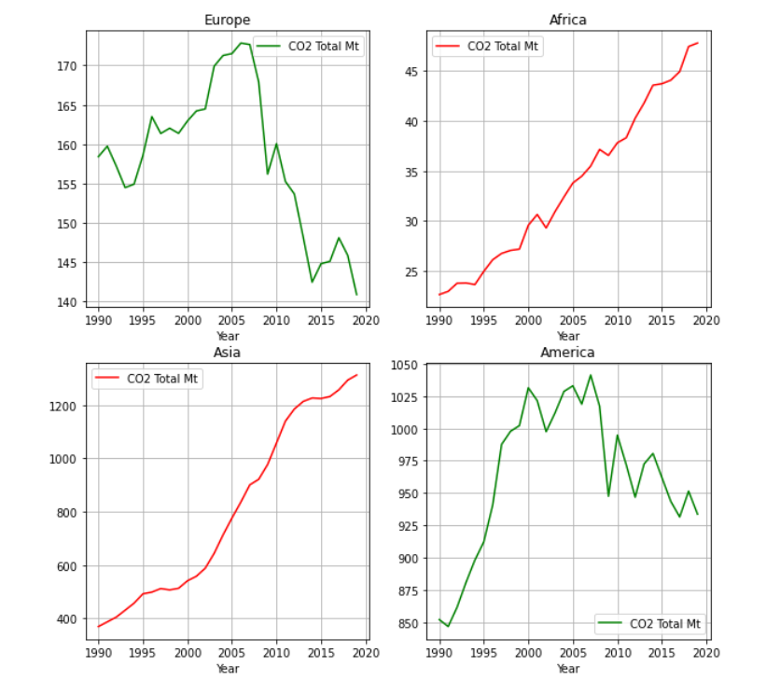
Co2
emission
Per
continents
Data Acquisition
Data Cleaning
EDA
Machine Learning
Conclusions

Slide 15
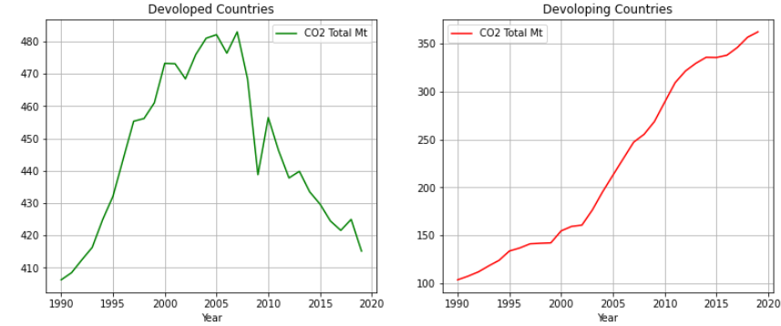
Developed VS Developing
___
___
Countries
Data Acquisition
Data Cleaning
EDA
Machine Learning
Conclusions

Slide 16
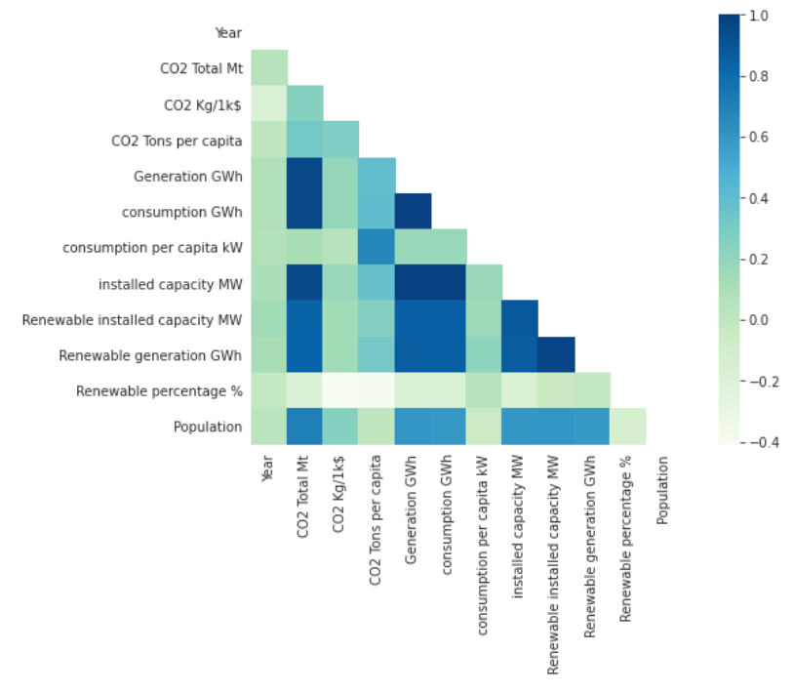
Heatmap of correlations
Data Acquisition
Data Cleaning
EDA
Machine Learning
Conclusions

Slide 17



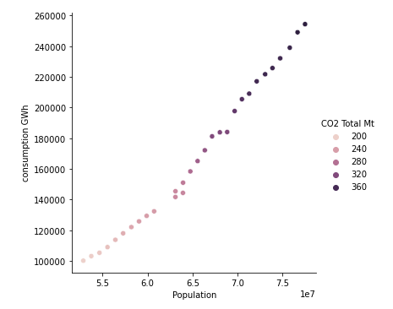
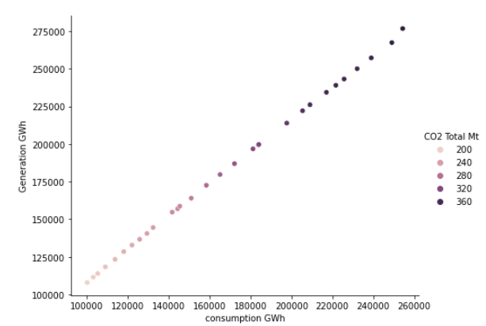
Energy consumption
VS
Population
Energy consumption
VS
Energy generation
Data Acquisition
Data Cleaning
EDA
Machine Learning
Conclusions

Slide 18
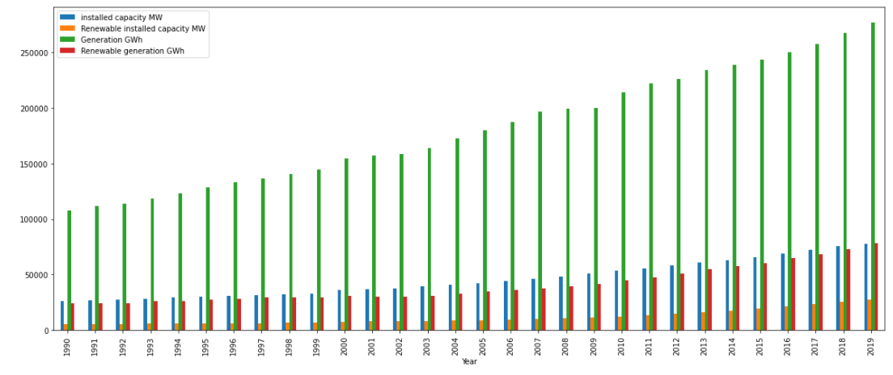
Global energy production trend per years
Data Acquisition
Data Cleaning
EDA
Machine Learning
Conclusions

Slide 19
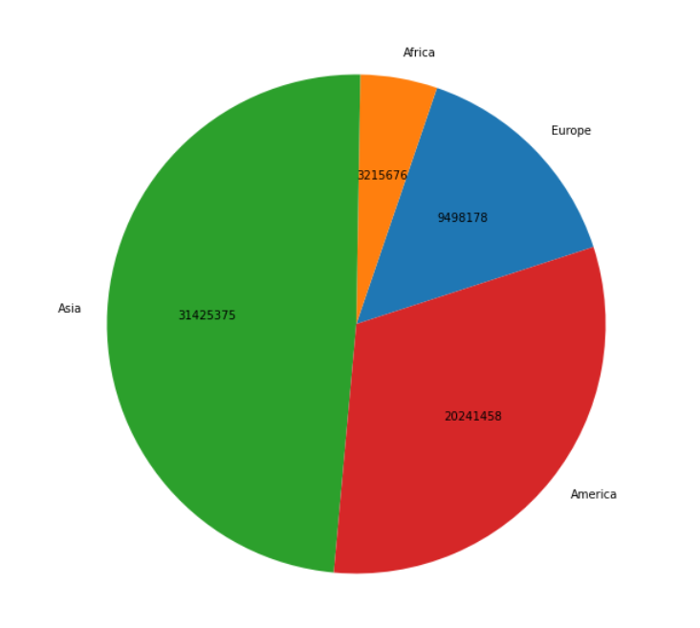
Cumulative CO2 emission
in mega tones per continents
Data Acquisition
Data Cleaning
EDA
Machine Learning
Conclusions
From 1990 till 2019

Slide 20
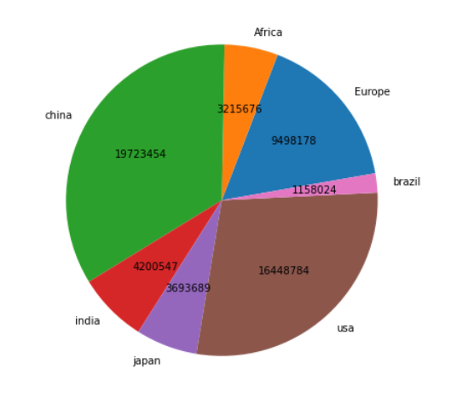
Cumulative CO2 emission
in mega tones
Data Acquisition
Data Cleaning
EDA
Machine Learning
Conclusions
From 1990 till 2019

Slide 21
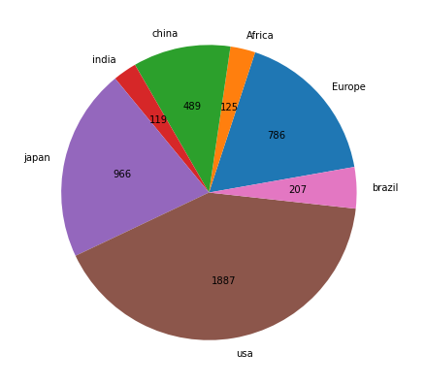
CO2 emission mean
in mega tones per capita
From 1990 till 2019

Slide 22

Machine Learning

Slide 23
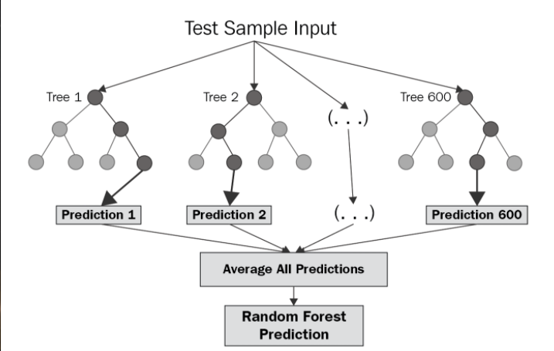
Random forest regression
Random Forest Regression is a supervised learning algorithm that uses ensemble learning method for regression. A Random Forest operates by constructing several decision trees during training time and outputting the mean of the classes as the prediction of all the trees.
Data Acquisition
Data Cleaning
EDA
Machine Learning
Conclusions

Slide 24


Our model prediction success:
Data Acquisition
Data Cleaning
EDA
Machine Learning
Conclusions

Slide 25
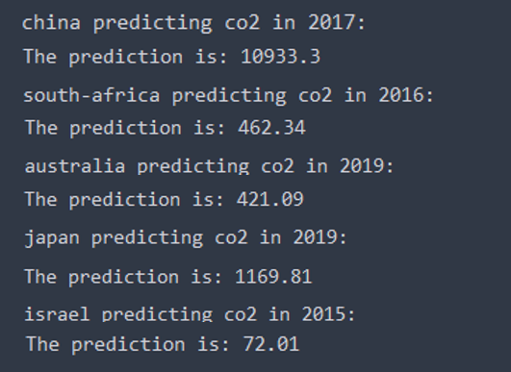


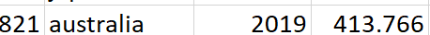


Prediction results
Records from our DataFrame:
Data Acquisition
Data Cleaning
EDA
Machine Learning
Conclusions

Slide 26

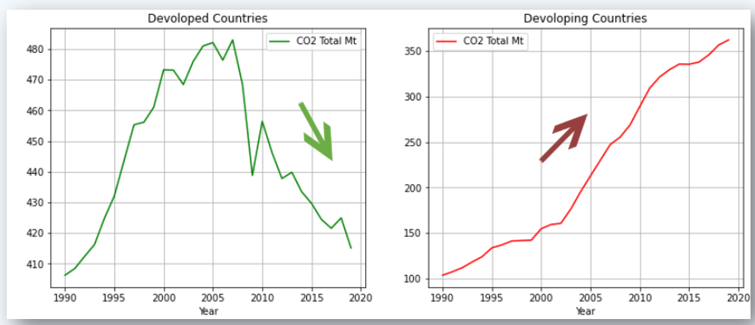


Conclusions
The developed countries point at their own efforts to reduce emissions when the large developing countries are currently releasing much more CO2.
On the other hand, developing countries emissions are for economic growth while developed countries emissions are more about standard of living.
Data Acquisition
Data Cleaning
EDA
Machine Learning
Conclusions

Slide 27


